Slide 1
WEB CONTENT MANAGEMENT
UNIT IV

Slide 2
Content Workflow
A content workflow is a series of tasks your team performs to take your content from ideation to delivery as efficiently as possible. Although it outlines the processes, a content workflow is also heavily reliant on the people, tools, and resources needed for content creation.

Slide 3
Content Workflow
Strategists, writers, editors, and managers are people you would have on your content team. Their tasks, seen in a workflow, include planning, writing, editing, publishing, and more; however, each function is not necessary for every content type.
Depending on the content type, your workflow will change. Businesses can publish various content like newsletters, blog posts, and social media posts. The content workflow is different for each asset.
For example, compare the publication of a newsletter and a social media post. The most evident difference in this process is that the content types go through different channels. Once you break down the workflows, you will discover that each may require separate people, processes, tools, and resources.

Slide 4
Content Workflow Management
Components of content creation process.
Process
People
Tools

Slide 5
Processes
To manage your content workflow, identify the steps needed to create content. They are:
Strategizing
Planning
Creating
Reviewing
Publishing
Analyzing
While this is the basic workflow for content, each step has supplementary processes depending on the content type.
You can build these extra steps as you create your content workflow. At this stage, it’s helpful to outline a content strategy.

Slide 6
People
An effective content workflow focuses on the processes needed to publish content, but people are arguably the most vital part.
One aspect of managing content workflow is identifying and managing key players.
These people are responsible for fulfilling the steps in the content creation process listed above.
For example, for strategizing, you’d need a strategist. For reviewing, you’d need an editor.
In conjunction with managing your people and their processes, content workflow management also covers the tools needed to complete the work.

Slide 7
Tools
For your content team to fulfill their roles and work through content creation processes, they need tools.
Content has to be created, edited, shared or managed somewhere. Managing your team’s content workflow means managing the tools it needs.
Content management systems, like CMS Hub, are essential for publishing blog posts.
Canva and Adobe Photoshop are great tools for design. These are just three of the many tools your company might add to its content tech stack.
As the content marketing industry booms, your business needs to expand to accommodate this growth.
This expansion reflects an increase in the people, processes, and tools associated with your content workflow.
The more comprehensive your workflow becomes, the more daunting it is to manage; however, integrating content workflow software can solve the problem.

Slide 8
Content Workflow Software
Content workflow software, or a workflow management system, is a program that manages the content creation process through planning, production, and publication.
Instead of teams using multiple methods and approaches to monitor the content process, workflow management systems help you create a centralized location for your team to visualize its processes.
It promotes the execution of your content strategy in alignment with company goals.

Slide 9
Content Workflow Software
The added benefits of using content workflow software include:
An increase in productivity
A reduction in errors
An improvement in workplace collaboration

Slide 10
Increase in Productivity
Without using a content workflow software tool, team members are left with extra work and time wasted.
These issues are removed with content workflow software because it is automated.
It eliminates sending email updates because the software sends them for you.
Content teams don’t have to guess the timeline of a project because the system manages it for them.
Everything happens quickly and efficiently.

Slide 11
Reduction in Errors
Nothing is perfect, and you can’t expect the same from your content workflow.
Even so, content workflow software helps reduce errors. It helps your team stay ahead of deadlines.
It allows you to identify what processes in the content workflow need adjustment.
Content management software gives your company the tools for improving your workflow.

Slide 12
Improvement in Workplace Collaboration
Content management software improves workplace collaboration between team members and the apps and platforms they use.
Executing your content strategy requires many different people who use various tools.
Workflow management software allows your team to notify and update another member while the software integrates with several content management systems, email providers, messaging services, and social media platforms.

Slide 13
Content Workflow Template
Content workflow software is fundamental in keeping up with your content strategy; however, you need the appropriate steps to build your workflow. Only then can you get the most out of the software. Where do you begin? Here’s how you can create your content workflow.

Slide 14
How to create a Content Workflow?
The people, processes, and tools necessary for executing your content strategy are helpful markers in creating your content workflow.
To create a content workflow, you need to:
Decide what content to create.
Create a breakdown of actionable tasks.
Assign roles.
Determine the time associated with each task.
Document your content workflow.

Slide 15
Decide what content to create
First, decide “what” you are creating.
Is it a social media post?
Is it a newsletter?
Your company has the choice of creating many content types like infographics, blog posts, video content, and more, and you will need to create a workflow for each.

Slide 16
Create a breakdown of actionable tasks
Once you are focused on a particular content type, outline the necessary steps needed to get it from strategy to publication.
Consider this sample workflow for a blog post. Its process might look like this:
Strategizing > Planning > Creating > Editing > Publishing > Analyzing
While these are broad tasks for creating a blog, this is where it needs to expand.
Strategizing typically includes performing content audits, creating buyer personas, and conducting keyword research.
Editing might involve implementing SEO techniques or adding images and links.
Every step in the process needs to be accounted for so it can be assigned to the appropriate team member.

Slide 17
Assign Roles
After you have the tasks for your content process, it’s time to decide who does them.
This step can help identify if anyone is at capacity in their role and if you need to bring in additional members.
Using our blog example above, this is how you might assign roles.
Strategizing > Content Strategist
Planning > Content Manager
Writing > Copywriter
Editing > Editor
Publishing > Content Manager
Analyzing > Content Manager
After assigning responsibility for each task, determine how much time is necessary for completion.

Slide 18
Determine the time needed for each task
To determine how much time you need for each task, consult your content team.
How much time does your writer say it takes them to write a 500-word post?
What about a 2500-word post?
Use the length of time they give you and build in additional time.
It can help your company avoid working with tight timelines or missing deadlines.

Slide 19
Determine the time needed for each task
After this step, your content workflow might look like:
Strategizing > Content Strategist (1 day)
Planning > Content Manager (<1 day)
Writing > Copywriter (2 days)
Editing > Editor (1 day)
Publishing > Content Manager (<1 day)
Analyzing > Content Manager (Ongoing)
Once you have outlined a process for the tasks, people, and length of time needed for creating your content, your content workflow is complete.

Slide 20
Document your content workflow
The last step in creating your content workflow is documenting it.
Companies typically use standard operating procedures (SOPs) to keep their teams aligned with the process.
Marketing Hub, Trello, and Evernote are examples of systems that give teams easy access to documents like SOPs.

Slide 21
DOCUMENT MANAGEMENT

Slide 22
Document Management
Document management is a system or process used to capture, track and store electronic documents such as PDFs, word processing files and digital images of paper-based content.
Document management can save you time and money.
It provides document security, access control, centralized storage, audit trails and streamlined search and retrieval

Slide 23
IBM case management
Automate more
See how automation improves a claims reimbursement process.
In this example, we’ll use an RPA bot with APIs for document capture and business rules to complete the process faster – and with fewer errors.

Slide 24
IBM case management
Claims reimbursement automation
An RPA bot processing emails, documents, cloud APIs and web apps
Additional automation by combining the bot with easy to use document capture and flexible business rules

Slide 25
IBM case management

Slide 26
IBM case management

Slide 28
Essentials
Less paper, more functionality
Document management has grown from digitized paper to include security, auditing and more.
More storage capacity
The storage capacity of a server is greater than a physical filing cabinet or warehouse.
Common attributes
Systems vary in scope but share attributes such as indexing, version control and more.

Slide 29
CMS vs. DMS
CMS | DMS
Content management systems are used to create and manage various types of digital content besides documents in the traditional sense. For example, in addition to being used for PDFs, Word files or Excel files, a CMS could be used to manage things like images, web pages, records and flash files. | DMS is a system that helps businesses to create, track and store digitized documents. A DMS is used to classify, retain and protect electronic information. It also supports versioning, collaboration and workflows.

Slide 30
How CMS and DMS Are Similar?
Document management systems and content management systems both do the following:
Help manage documents.
Facilitate information creation, retention and distribution.
Provide centralized storage for data.
Ensure fast and easy information retrieval.
Provide high-level information security.
Support content-driven collaboration.
Offer automated workflows.

Slide 31
How CMS and DMS Differ?
A DMS manages structured data and is focused on documents in the traditional sense in such formats as Word, PDF, PowerPoint, Excel, etc. A CMS, on the other hand, can handle both structured data and unstructured data, such as web content (HTML and PDF files) and digital assets (images and audio and video files).
The key purposes of a DMS are regulatory compliance and workflow management, while the key purposes of a CMS are storage, retrieval and publishing of content.
DMS applications have advanced imaging and scanning capabilities, such as optical character recognition (OCR), handprint character recognition (HCR), optical mark recognition (OMR) and more. CMS tools usually don’t support those functions.
Integration with enterprise systems (such as enterprise resource planning and customer relationship management tools) is essential for a DMS but secondary for a CMS.

Slide 32
EDM and ECM: One System or Two?
Enterprise document management systems are sets of technologies designed to handle creation, capture, indexing, storage, retrieval, routing and distribution of corporate documentation.
Enterprise content management, on the other hand, is a term used to refer to a set of strategies, methods and tools used to capture, manage, store, preserve and deliver corporate digital data.
As is the case with DMS and CMS, EDM and ECM overlap. Sometimes, it’s difficult to say whether they are two different systems or one entity.

Slide 33
EDM and ECM: One System or Two?
1. Capturing information: Creating information by digitizing paper documents, or obtaining, organizing and structuring information in electronic formats.
2. Managing information: Connecting, modifying and employing information. Specific aspects of managing information include the following:
Document management.
Collaboration.
Web content management.
Records management.
Workflow/business process management.
3. Storing information: Short-term storage of files in accessible folders to allow editing of files so frequently changing information can be updated.
4. Preserving information: Long-term retention of infrequently changing information as part of regulatory compliance efforts.
5. Delivering information: Providing clients, partners or auditors with required information upon request.

Slide 34
Features of Document Management Software
Security features such as customizable access restrictions
Ability to store various file types
Search functions for quick location and access to important files
Document history for auditing and tracking
Version control for documents and backup storage
Ease of use

Slide 35
COLLABORATION

Slide 36
What is collaboration?
Collaboration is a recurrent process where two or more people work together to achieve shared goals by sharing knowledge, learning and building consensus.
The common goals could also be an intellectual endeavour or a means of creation of new knowledge.
These include sharing of planning, goal setting, decision making, problem solving, assuming responsibility, open communication, cooperation, coordination and recognition and acceptance of separate and combined areas of activity.

Slide 37
Tools for Collaboration on the Web
The Internet enables interactive collaboration on a massive scale which is not easy in other real world communication channels.
Collaborative content on a massive scale is a distinctive feature of the World Wide Web.
There is also digital reuse of content.
Collaborative software was originally designated as groupware. The term ‘groupware’ was coined by Peter and Trudy Johnson-Lenz in 1978 and defined as “intentional group processes plus software to support them”.

Slide 38
Tools for Collaboration on the Web
Groupware integrates co-evolving human and tool systems, yet is simply a single system.
Groupware tools are instruments which can be used to implement groupware functions.
Groupware is built around three key principles depending on the level of collaboration (Lotus Notes):
Communication
Conferencing
Coordination

Slide 39
Tools for Collaboration on the Web
i) Communication:
This can be thought of as an unstructured interchange of information.
For example, a phone call or an IM Chat discussion.
ii) Conferencing (or collaboration):
This refers to interactive work towards a shared goal.
For example, brainstorming or voting.
iii) Co-ordination:
This refers to complex interdependent work towards a shared goal.
For example, in a sports team everyone has to contribute the right play at the right time as well as adjust their play to the unfolding situation but everyone is doing something different - in order for the team to win. That is complex interdependent work towards a shared goal of collaborative management.

Slide 40
Features of Collaboration Tools
Collaborative software and tools promote communication, enable sharing of a text document, a photograph or other similar objects, allow natural interactions and be easy to use and learn.
Strong Communication Capability:
The most important feature of a collaboration tool is its ability to facilitate communication and interaction between participants.
This can be through video, audio or simple text.
Easy-to-Understand Interface:
The interface of the tool should be easy and intuitive to navigate, perhaps emulating an existing tool or an aspect of the physical world.
A user’s ability to simply pick up, adapt to and use a tool considerably diminishes extensive training and supervision needs.
Capability and Expectation of Collaboration:
To encourage input from participants, a collaboration tool should make it clear that the input is expected and will elicit a response.
For example, an online presentation can be an ideal tool for collaboration, but it has to be made clear to the audience that they have to respond and interact with others instead of passively watching a webcast.

Slide 41
Collaborative Content Development
In collaborative content development, individuals work together in a coordinated fashion towards a common objective.
The users come together as a team, primarily for the accomplishment of a set goal.
The collaborative work is facilitated by a collaborative software which provides tools that aid communication, collaboration and the process of problem solving to individuals separated by physical and geographic distances.
The collaborative tools support individuals involved and also the interactions that take place between them during group decision making process.
Collaboration and content quality management can be taken care of through the guidelines prepared by the community.
Web-based applications have made it possible to bring ideas together and develop content collaboratively by providing easy to use, user-friendly applications.

Slide 42
Collaborative Content Development
A number of applications and initiatives are there which enable different types of collaboration for different types of content.
The Web offers possibilities of collaboration in various areas.
These include online encyclopaedias, document management, project management, community or social networks, Learning Management System (LMS) and Content Management System among several others.
Groupware, content management systems and portals offer a rich set of tools for collaboration.
They have collaborative authoring tools and provide separate areas with member profiles, areas for online discussions, file and document sharing and for providing comments and feedback.
In view of technological developments, content is increasingly being created in a collaborative manner with multiple authors and different users commenting, reviewing and providing feedback for a given document.

Slide 43
VERSIONING

Slide 44
Versioning
Versioning means keeping track of different versions of content when it’s changed by editors.
This brings a few advantages.
Roll back of changes
See changes in time
Used to audit and monitor modifications
Control when a new version is available

Slide 45
Draft, Submitted, Published, Archived
In our communication preparation process, we had to support the following states of assets:
draft — a work-in-progress version, only author or editor can modify it, this version cannot be used in other assets,
submitted — a stable version that was submitted for review via a workflow process, it cannot be used in other assets yet, this will be possible after approving it,
published — basically, it’s the same version as submitted, but it can be used by users to create a communication,
archived — a previous version of an asset where a new submitted version already exists, it cannot be used in other assets, but it is still referenced from already published assets and used in communication.

Slide 46
Versioning
This is not the final solution as there are plans to support more sophisticated flows and states.
Implement other relations in Dgraph.
previous version — a pointer to a previous version if it exists,
next version — a pointer to the next version if it exists.

Slide 47
Versioning
So when you create a first version of an asset, which is a draft, and then submit it, you will get a node with neither previous nor next relation on it.
Yet, when you create another version of an existing asset, then both nodes representing this asset will have next or previous relation:

Slide 48
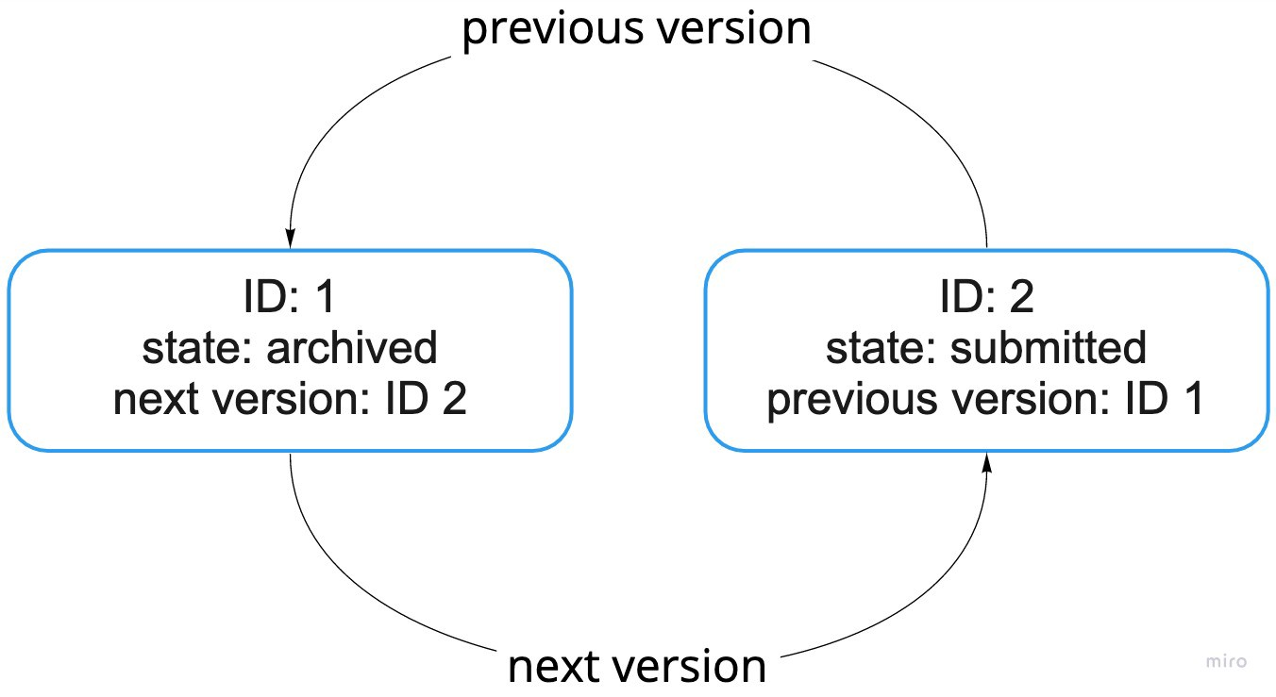
So when you create a first version of an asset, which is a draft, and then submit it, you will get a node with neither previous nor next relation on it.
Yet, when you create another version of an existing asset, then both nodes representing this asset will have next or previous relation:

Slide 49
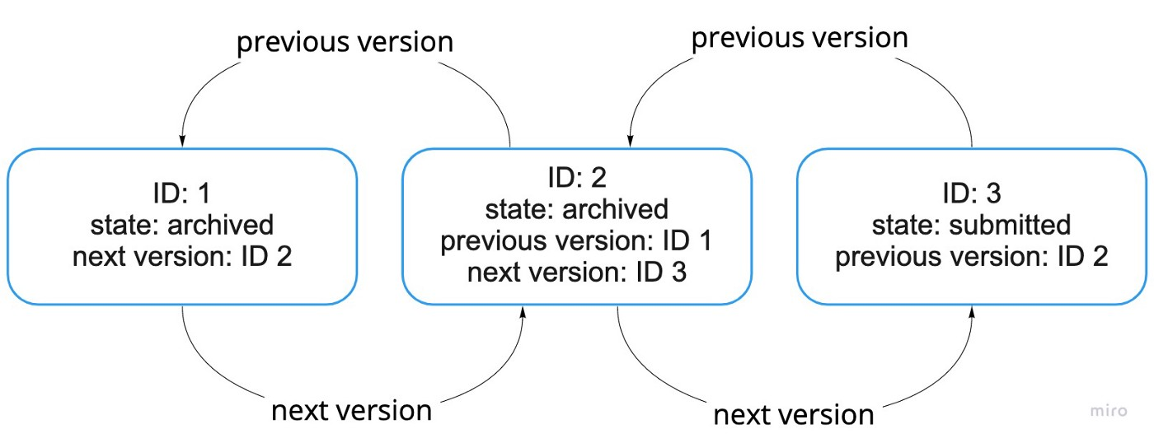

Slide 50
Static and version ID
Having previous/next relations required us to implement a universal identifier of each asset.
An ID that can be used in references to that asset and in our web designers when opening the asset to view or edit it.

Slide 51
Static and version ID
static ID — an id assigned to the first version of the created asset and it never changes during the whole lifetime of the asset,
version ID — an unique ID that is used to identify each particular version of the asset in the linked list, you can also used it in Dgraph queries when looking for the exact asset version.

Slide 53
New Draft Version
When creating a new version (a new draft), you can start from the latest submitted version only, when the draft already exists and you have created it, exactly this version (a draft version) will be used.
When using one asset in another asset (a text content in another text content), you can only select a submitted version of the asset. And once the relations uses/used by were set and the outer asset was submitted, the versions were sealed.

Slide 54
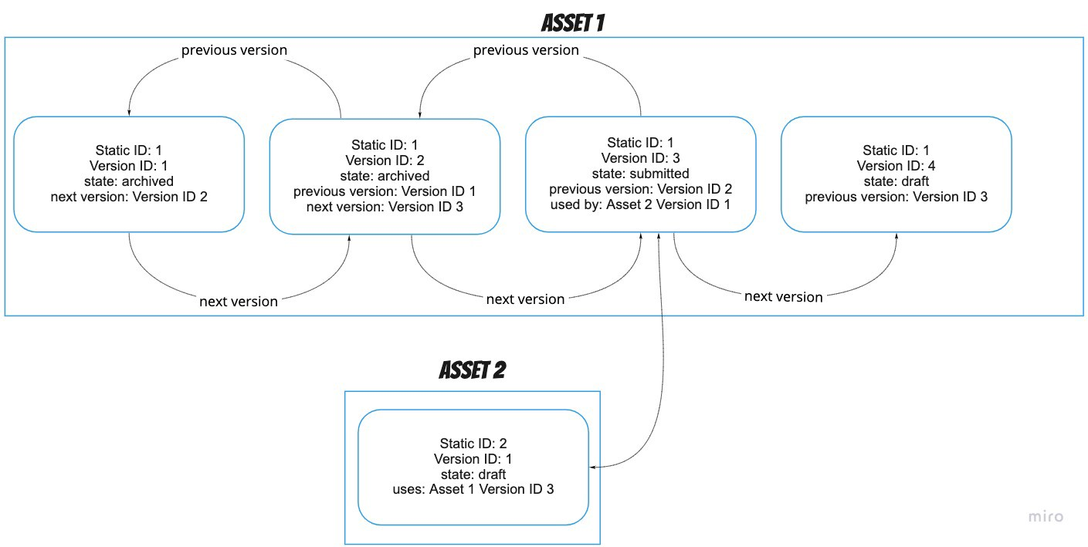

Slide 55
New Draft Version
By implementing Static and Version IDs, with support of uses & used by and previous & next version relations, we were able to implement all the requirements that our CMS had to fulfill.

Slide 56
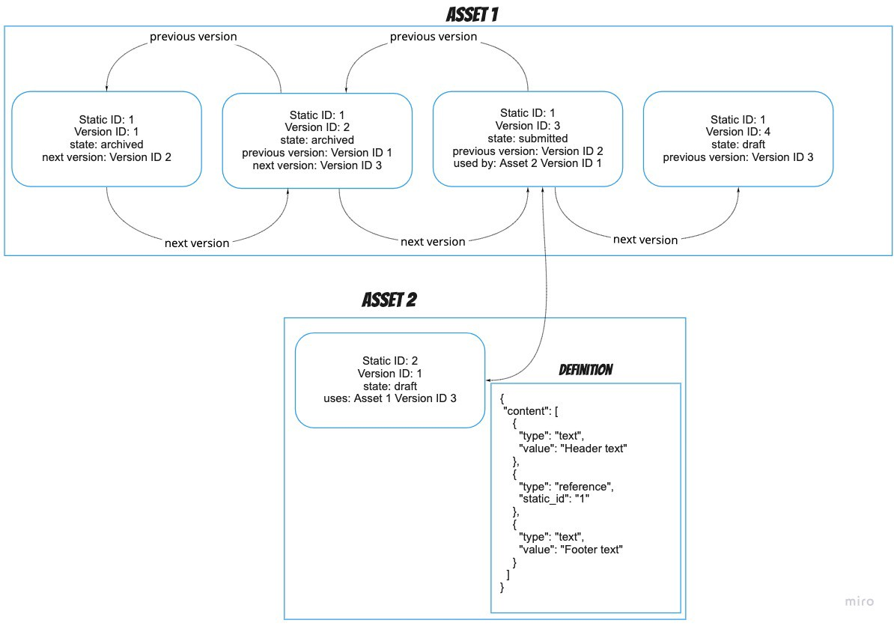

Slide 57
Different versions of assets
Another requirement that was discovered during development process was the ability to use different versions of assets used in a template to assemble a test communication.
each asset is represented by two structures:
a node in graph database (a node in Dgraph) and
a content definition (either JSON or a binary one stored in Cassandra).

Slide 58
Assembling Process
the first step was to collect all the versions used in the graph of assets
This is just a simple map (we called it the Reference Map), where keys were Static IDs and values Version IDs.
Having the Version IDs, we exactly knew which versions of assets to use.
So when the assembler was processing a given definition and detected a reference to another asset, through the Reference Map it was fetching a proper version of the asset from our CMS.
You can easily imagine a situation when the Reference Map is modified on fly by a user to check if a new version of the asset will fit the old shoes, so their can test the communication before even publishing a new version.

Slide 59
Advantages of Versioning
Easy traceability
Enhanced performance
Efficient content management

Slide 60
Version control vs. Versioning
Version control is shorthand for a system that keeps people from stomping on each other's work in collaborative environments.
Enforced through content check-in / check-out facilities that prevent two or more people from working simultaneously and unknowingly on the same item
When you try to edit something that someone else has "checked out," the system ideally alerts you that the item is "locked," tells you who possesses the content item at that point, and potentially gives you the option to override their lock.

Slide 61
Version control vs. Versioning
Content contributors in distributed publishing systems usually find version control tremendously helpful, but it sometimes comes at the expense of collaboration.
When only one person can have a content item checked out at any one time, processes can become very linear, and you can see added stress on workflow routines (such as excessive looping between author and approver).

Slide 62
Web Content Management Tools
WordPress
Textpattern
MODX
Joomla
Silverstripe CMS
Radiant
Concrete CMS
Contano
Microweber

Slide 63
WORDPRESS

Slide 64
What is WordPress?
WordPress is the most popular CMS on the market, powering 65.2% of websites whose CMS we know.
That translates to 42.4% of all websites – nearly half of the internet.
It is a popular option for those who want to build a website or blog.

Slide 65
WordPress
WordPress is an open-source content management system (CMS) software used to build, modify, and maintain websites. In technical terms, WordPress is written in PHP and run on a MySQL or MariaDB database. In addition, WordPress features include plugins and themes, among others.

Slide 66
How does WordPress Work?
WordPress runs on a database system that allows you to add, modify, and organize files, themes, plugins, and all types of content.
Each WordPress user has access to the dashboard to manage their website in one place.

Slide 67
Benefits of WP
Free and opensource
Flexible and customizable
Scalable platform
Easy to use

Slide 68
WordPress.org
WordPress.org houses the free content management system software used to run a self-hosted version of WordPress.
To build a self-hosted website, you must first register your domain name and purchase a web hosting plan.
The type and quality of your chosen web hosting plan will determine the performance of your website.
Additionally, users can exercise more control over the web server space they’re renting from the web hosting provider by self-hosting.

Slide 69
WordPress.com
WordPress.com is a hosting company that uses a website builder based on the WordPress content management system for all the websites it hosts.
Unlike its self-hosted counterpart, WordPress.com is hosted, which means that it manages the web servers that store its users’ websites.
Users who sign up for the service for free are required to use a branded domain name, such as yourwebsitename.wordpress.com.
To use a custom domain name, one must upgrade to a paid plan.

Slide 70
WordPress Features
Admin Dashboard and Settings
Content Editor
Theme customizer
Plugions and Widgets
WooCommerce
Visual Composer
Yoast SEO
Wordfence Security

Slide 71
Admin Dashboard and Settings

Slide 72
Content Editor

Slide 73
Theme Customizer

Slide 74
Plugins and Widgets

Slide 75
Sites to create with WordPress
Blogs
Portfolios
Business Websites
Charity Websites
Online Stores

Slide 76
Pros of WordPress
Low cost
Easy installation and updation
Simple to manage
Custom design
Custom functionality
Helpful community
Open source software

Slide 77
Cons of WordPress
Security concerns
Third-party content
Page load time

Slide 78
Steps to create a WP site
Buy a domain name.
Choose a hosting service provider.
Buy a web hosting plan.
Install WordPress.
Customize the website.
Start creating content.
Promote the website.

